Slide 1
Phishing Awareness Simulation Using Social Engineering Techniques
Understanding, Identifying, and Preventing Social Engineering Attacks

Slide 2
What is Phishing?
🟣Definition: A cybercrime where targets are contacted by email, telephone, or text message by someone posing as a legitimate institution. ​🟣The Goal: To lure individuals into providing sensitive data such as
1.Personally Identifiable Information (PII)
2.​Banking and credit card details
3.Corporate login credentials
🟣Key Stat: Over 90% of successful data breaches start with a phishing email.

Slide 3
How Phishing Works (The Cycle)
​The Research: Attackers gather info on targets (via LinkedIn, Social Media).
​The Hook: A deceptive message is sent (the “Lure”).
​The Exploit: User clicks a link or opens an attachment.
​The Catch: Data is stolen, or malware/ransomware is installed.

Slide 4
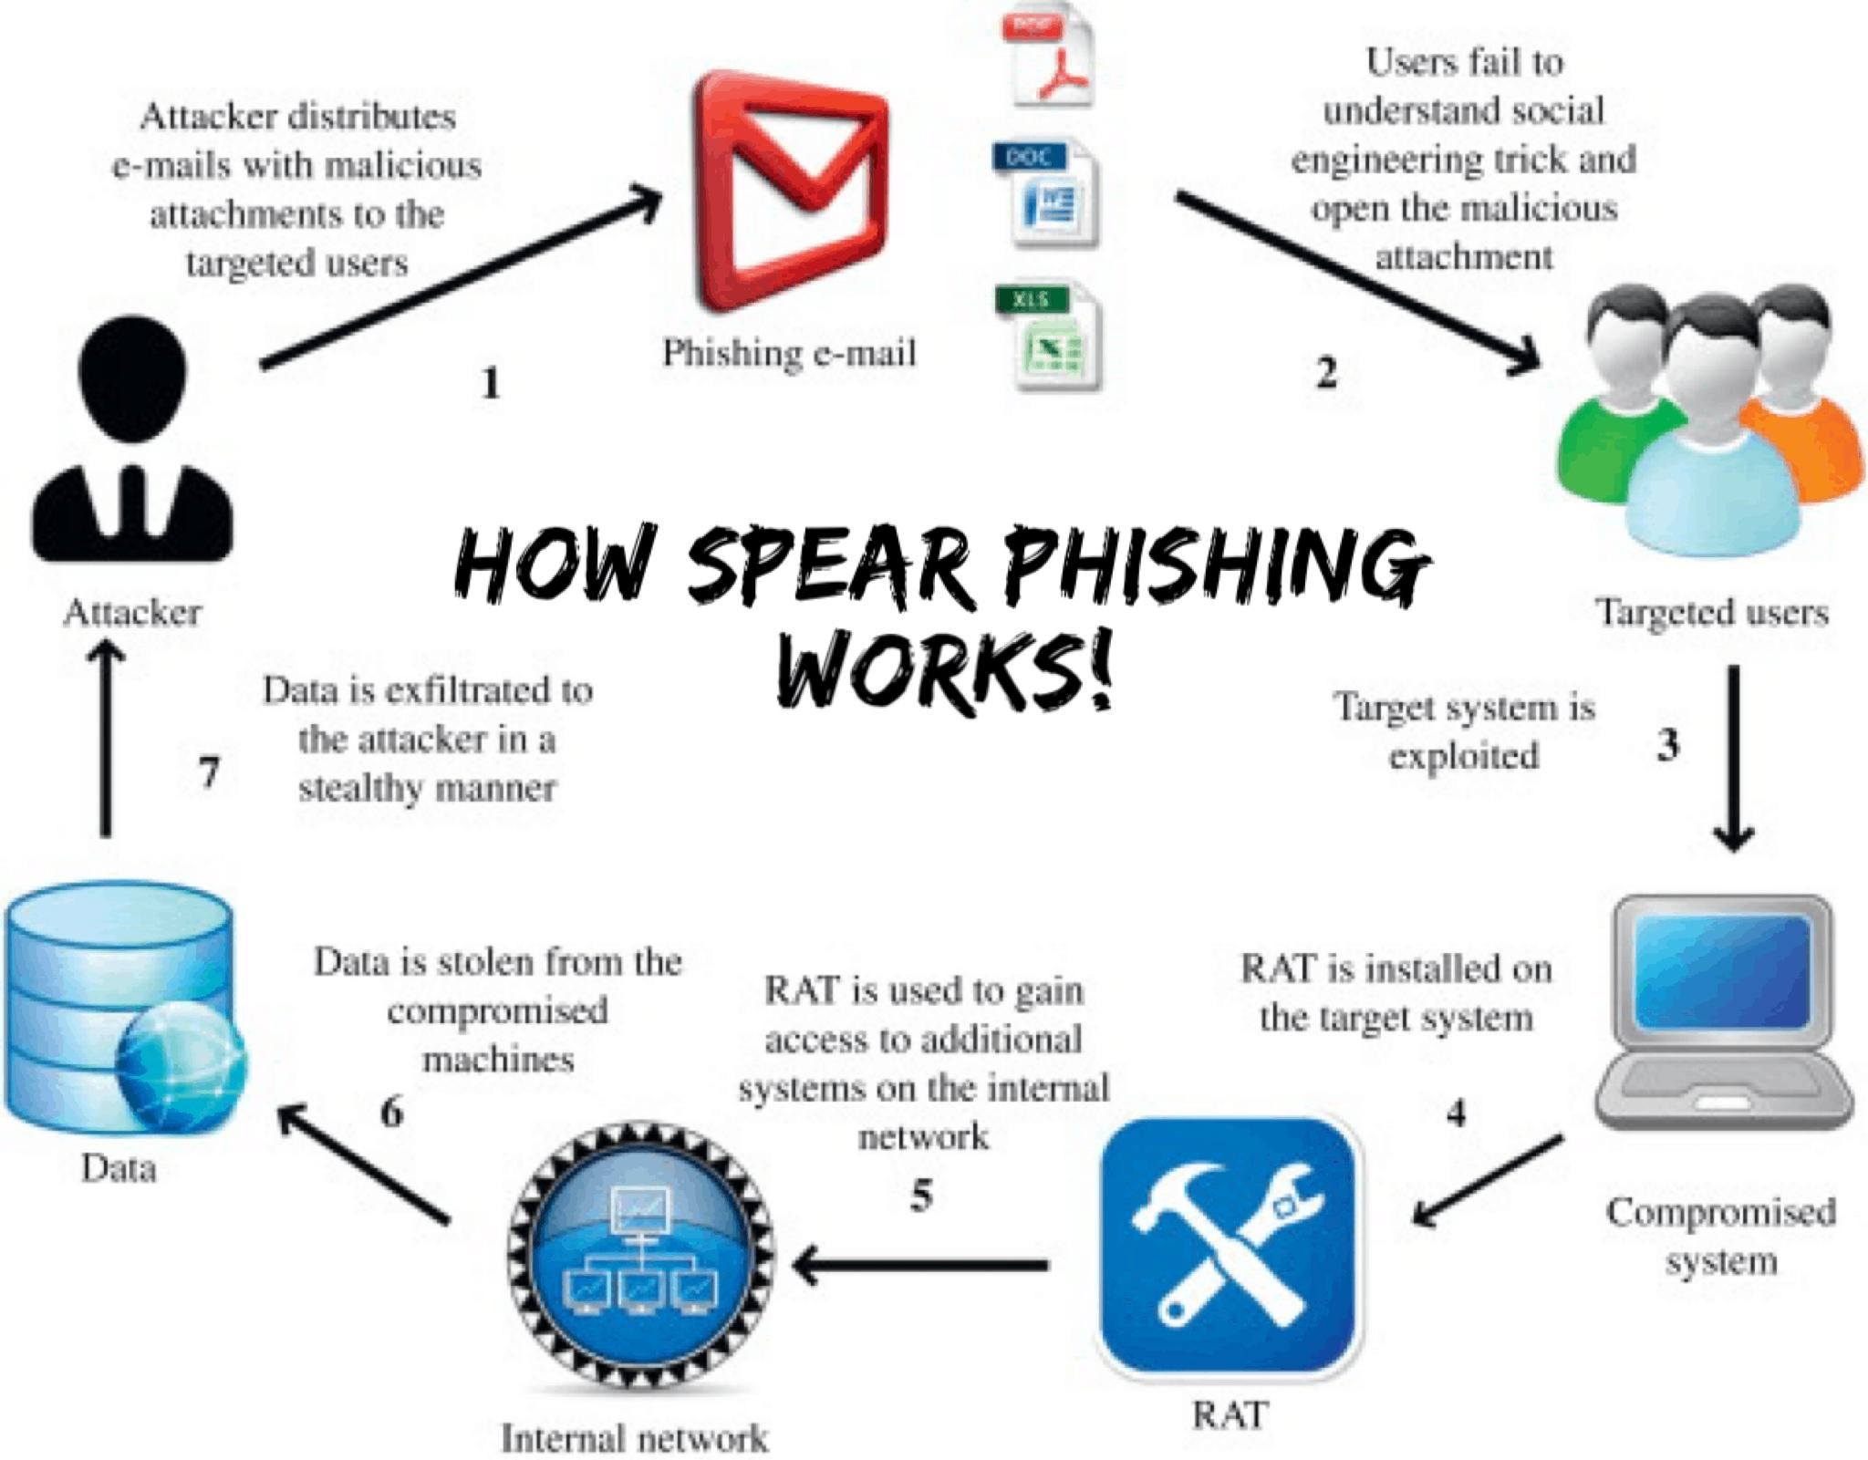

Slide 5
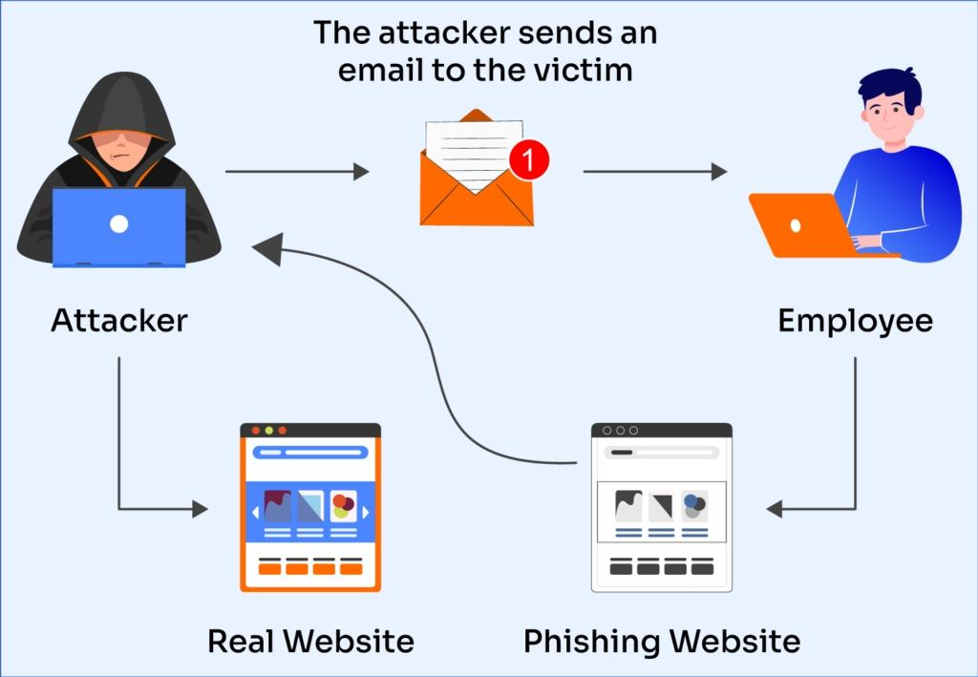

Slide 6
Types of Phishing
Spear Phishing Targeted at a specific individual or department. Whaling High-level attacks targeting CEOs and Executives.
Smishing Phishing via SMS/Text messages.
Vishing Voice phishing (fake phone calls or automated IVR).
Angler Phishing Fake social media accounts “helping” customers.

Slide 7
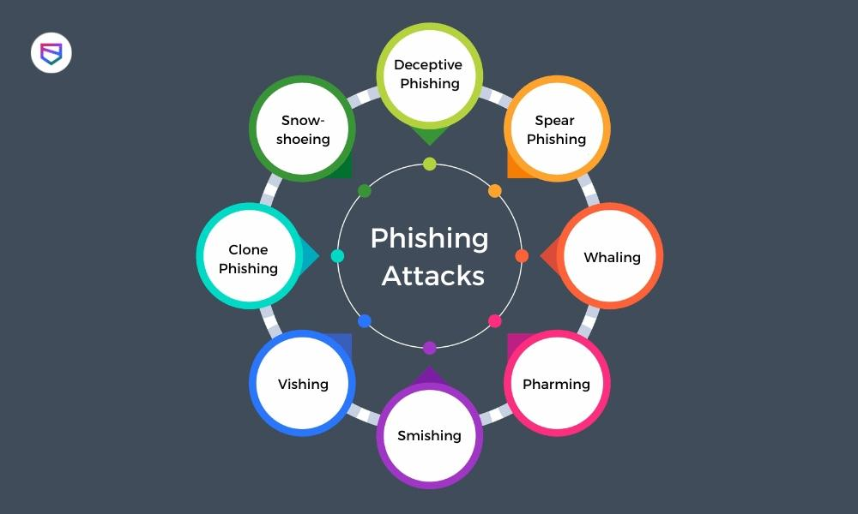

Slide 8
Anatomy of a Malicious Email
​Display Name Spoofing: The name says “IT Support,” but the email address is scammer@gmail.com.
​The Sense of Urgency: “Action Required,” “Account Suspended,” or “Final Notice.”
​The Hidden Link: Hovering over a button reveals a suspicious URL (e.g., wellsfarg0-secure.net).
​Generic Salutation: Using “Dear Valued Member” instead of your actual name.

Slide 9
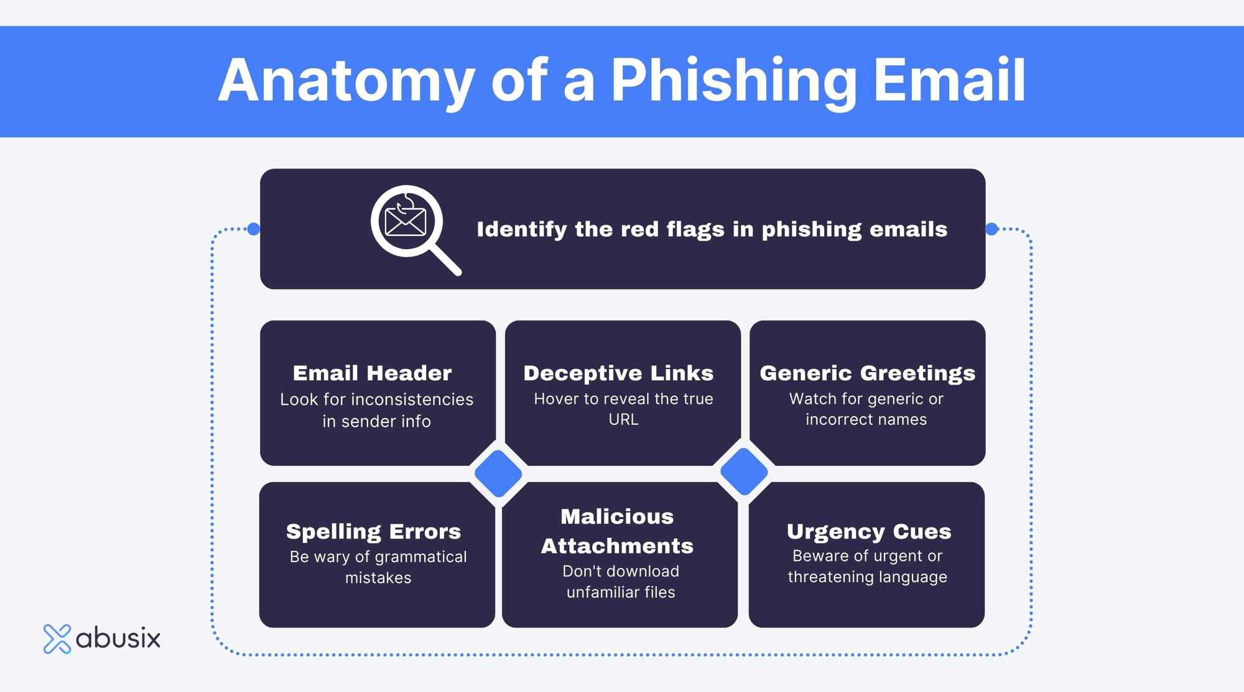

Slide 10
The New Frontier of Phishing
Quishing: Mention why QR codes are the new favorite “blind spot” for security.
​Trusted Services: Explain that even “Real” notifications from Google/Microsoft can lead to “Fake” places.
​The Fix: Never log into an account via a link. Instead, go directly to the official website (e.g., type paypal.com yourself) to check for alerts.

Slide 11
How to Protect Yourself (Best Practices)
​Check the Sender: Verify the email address, not just the name.
​Multi-Factor Authentication (MFA): The #1 defense. Even if they get your password, they can’t get in.
​Verify Offline: If a “boss” asks for a weird wire transfer, call them to confirm.
​Software Updates: Keep browsers and antivirus updated to catch known malicious sites.

Slide 12
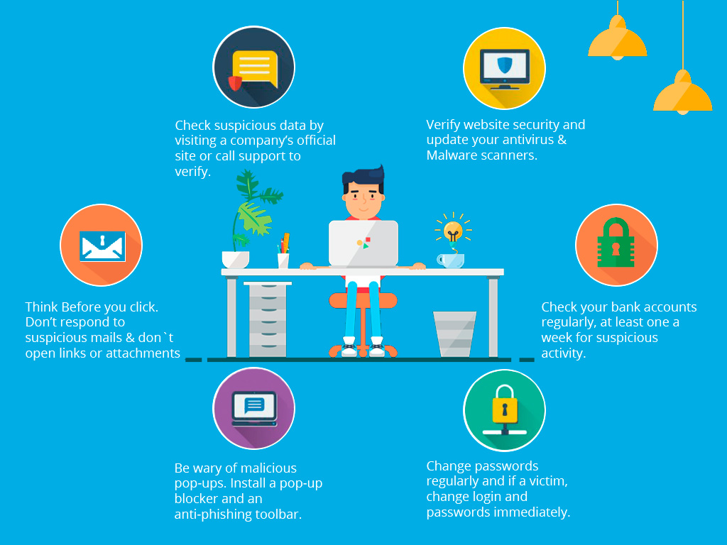

Slide 13
Emergency Response Plan
​Disconnect: If you downloaded a file, disconnect from the Wi-Fi/Internet immediately to stop data being sent back to the hacker.
​Report: Notify your IT or Security department immediately (don’t be embarrassed—speed is key).
​Reset: Change your passwords from a different device.
​Monitor: Check your bank and credit statements for unusual activity.

Slide 14
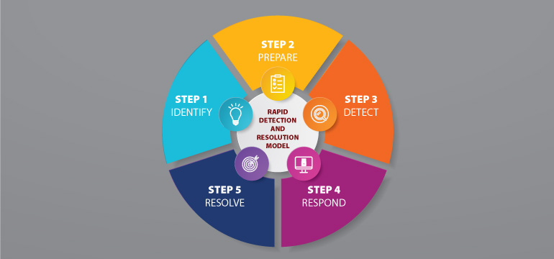

Slide 15
Conclusion
Phishing is a constantly evolving threat that relies on human error rather than technical glitches. By staying skeptical of urgent requests, double-checking links, and using tools like Multi-Factor Authentication, you can effectively shut the door on attackers. Ultimately, the best defense is simply to stop, look, and think before you click

Slide 16
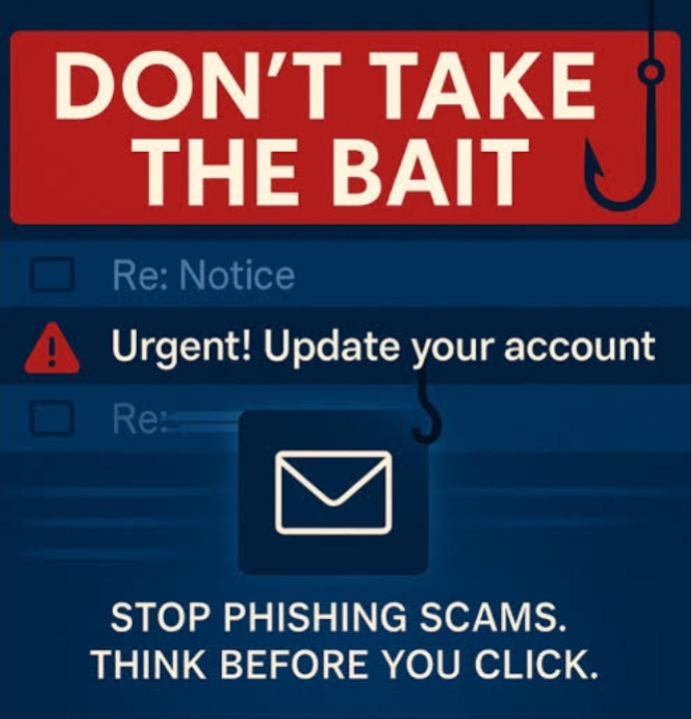
Cybercriminals don't 'hack' in anymore; they simply log in using the keys we give them. Don't hand over your keys.
​Stay Alert. Stay Informed. Stay Secure.

